Slide 1
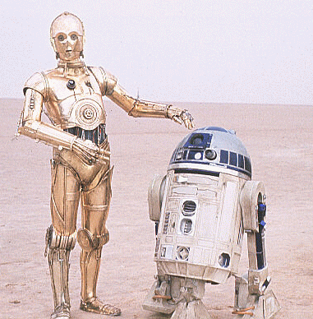
From A Galaxy Far, Far Away…
Networks is bringing Star Wars to YOU!
The office of the Chairman invites
you and your family for food & fun as
our guest at
Star Wars: The Magic of Myth
The Museum of Fine Arts, Houston
1001 Bissonnet (at Main)
Monday, March 19
7:30 p.m.
RSVP by March 14
Lisa Costello – x31819

